Slide 1
ELDON LEAP
Board of Education 19-20 External Evaluation Report
May 2021

Slide 2
External Evaluator Guided Reflection Process
Data Collection
Survey
Program Quality Assessment
DESSA - SEL Assessment
Local Context of Program
Program Summary
Program Action Plan

Slide 3
Data Collection
Annual Surveys
Parent
Student
Staff
Regular Day Administrators
Grades
Test Scores
Attendance
Discipline
Special Populations

Slide 4
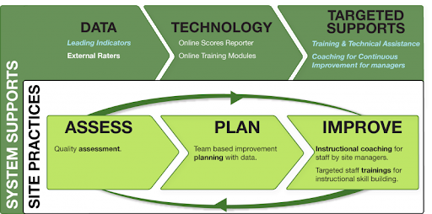
Program Quality Assessment
Youth and School Age
Certified Observer

Slide 5
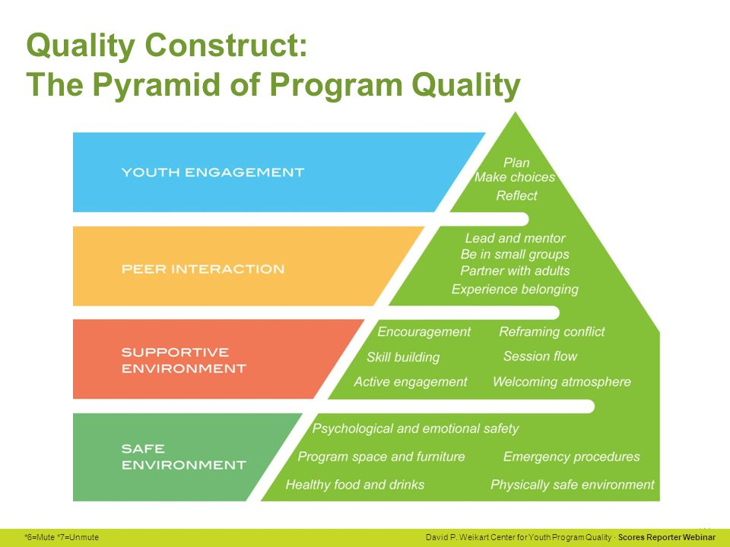
PQA

Slide 6
DESSA
Devereux Student Strengths Assessment
Afterschool Professional
Regular Day Teacher
Curriculum
Adult Activities
Self-Awareness
Self-Management
Social-Awareness
Relationship Skills
Goal-Directed Behavior
Personal Responsibility
Decision-Making
Optimistic Thinking

Slide 7
Goals of 21st CCLC
Goal 1: Academic Achievement & Efficacy
Goal 2: Program Quality
Goal 3: Youth Outcomes

Slide 8
Summary of LEAP 19-20 Data
Areas of Strength
High Quality
Excellent Community/School Support
High Parental Approval-More Productive
Youth Driven Programming
Variety of Activities
Positive Relationships with Supportive Adult
Positive Linkage to Regular Day
Areas of Improvement
EMS Reading Efficacy
Engagement & Interaction at All Sites
Additional Training/Onboarding
Family Engagement
Career Awareness & Post Secondary Access

